Slide 1
Rossmann Sales Forecasting
-Phoenix

Slide 2
Abstract
Rossmann operates over 3,000 drug stores in 7 European countries
Store sales are influenced by many factors, including promotions, competition, school and state holidays, seasonality, and locality
Reliable sales forecasts enable store managers to create effective staff schedules that increase productivity and sales itself

Slide 3
Data Set
Rossmann’s dataset contains sales data and store information from 1,115 stores across Germany
By analyzing the customer data, we can forecast sales and take decisions to improve customer experience which is also a critical factor to focus on as an organization
Data files | Description
train.csv | Historical data including sales
test.csv | Historical data excluding sales
store.csv | Supplement information about the sales

Slide 4
Hypothesis 1
The sales increase as the competition distance increases

Slide 5
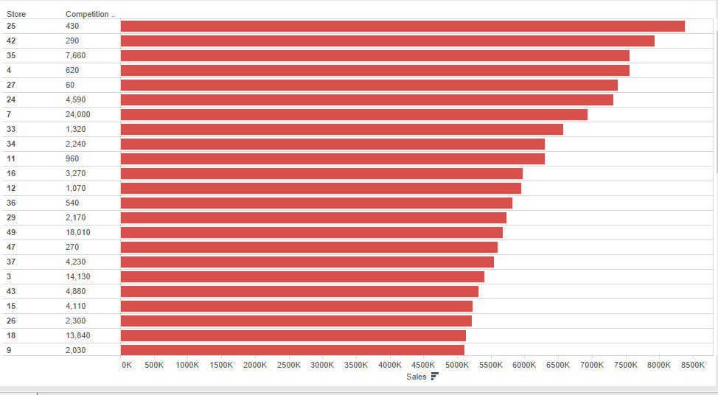
Sales by competition distance

Slide 6
Hypothesis 2
Higher sales are seen during promotional offer period

Slide 7
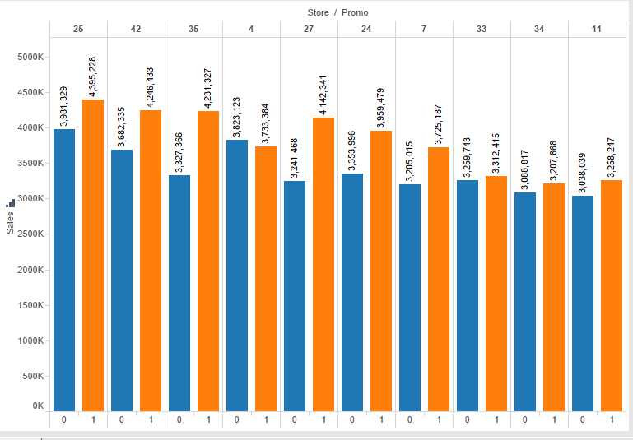
Sales against promotions

Slide 8
Hypothesis 3
The frequency of customers is more during promotional offer period leading to higher sales

Slide 9
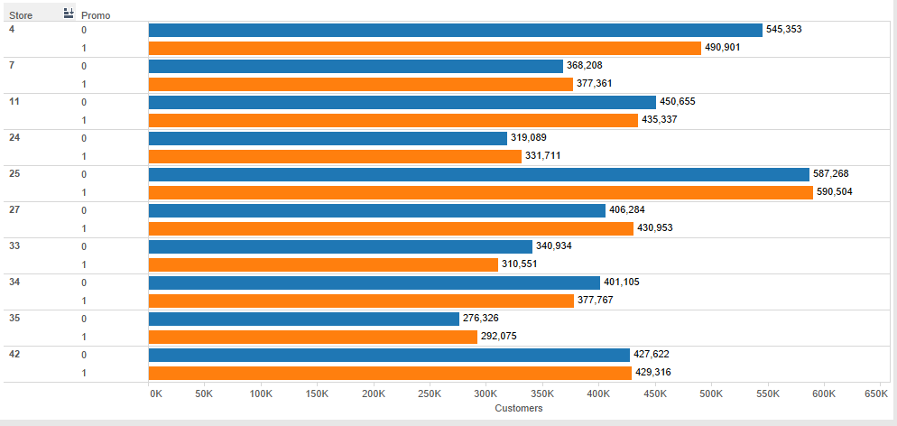
Number of customers against promotions

Slide 10
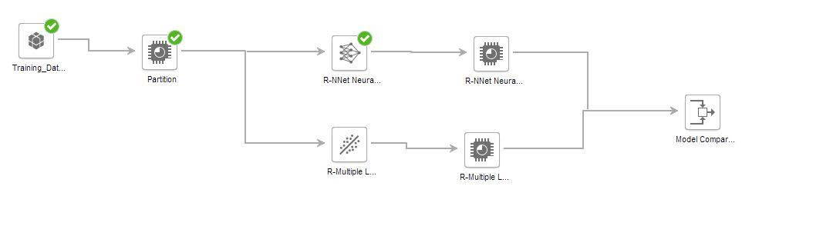
Predictive Model

Slide 11
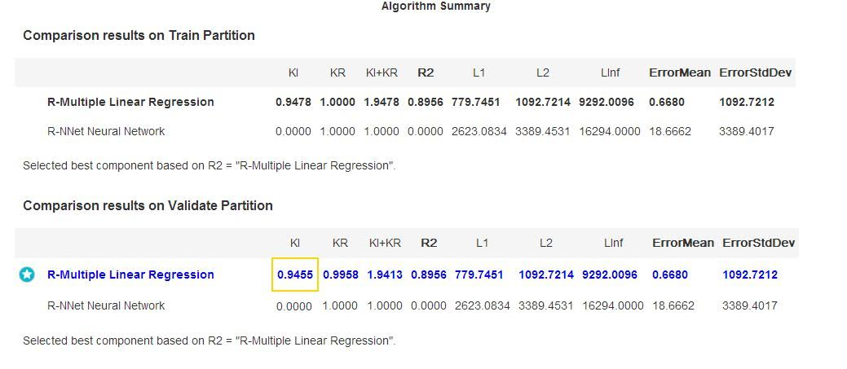
Model Comparison Statistics

Slide 12
Regression Analysis
Predicting the sales of Rossmann stores
Model used: Multiple Linear Regression
Sales = -37.45 * DayofWeek + 6.968 * Customers + 1077 * Open + 1146 * Promo +0.032 * CompDist + 37.10
Correlation Coefficient: 0.8986

Slide 13
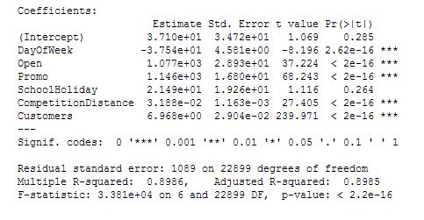
Regression Table

Slide 14
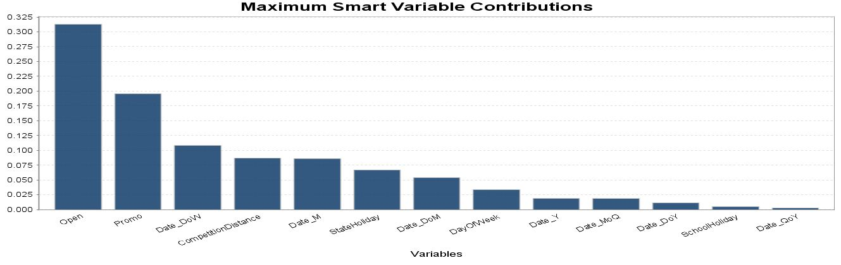
Parameters Affecting Sales

Slide 15
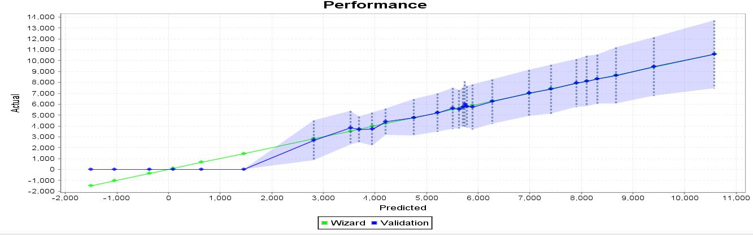
Model Performance

Slide 16
Thank you!
Questions?

